Slide 1
Leverage White-Collar Workers with AI
Stephan Jüngling , Angelin Hofer - AAAI Spring Symposium, AAAI-MAKE 2019
Notes:
ESP Einschreibung
Reflexion Berufspraxis
UQM

Slide 2

Agenda
Process automation in the are of blue-collar & white-collar workers
Our current design thinking of automation
Adding AI components to cars: Ollie fleet challenge
RPA: Rethinking about repetitive tasks of white-collar workers
NLP: Creating meeting minutes – can AI replace humans?
Coming up with co-working scenarios for blue-collar & white-collar workers
Towards a process-oriented collaborative workplace
Notes:
Meeting minutes generation: observations, findings & conclusion
Identified Problems by Humans:
Key activities: Listening, taking notes, reconstruction and extraction of relevant information – a very challenging task!
Difficult to capture the meeting content
Distinguishing between important and unimportant information
NLP Tools
Difficult to capture the meeting content
Not all AI technologies are mature enough for fully automated meeting minutes
Speech recognition and the generation of a transcript provides great value for reconstructing the information shared after the meeting
Meeting minutes generation: observations, findings & conclusion
Typical problems in creating meeting minutes
Towards a meeting minutes assistant – master thesis statement
Meeting minutes generation: observations, findings & conclusion
Simulations of meeting minuts creation process – Human and AI actors

Slide 3
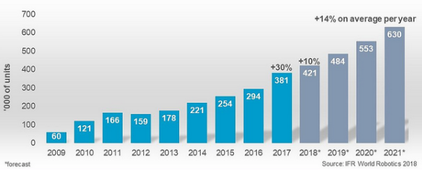
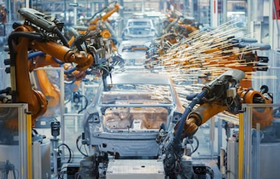
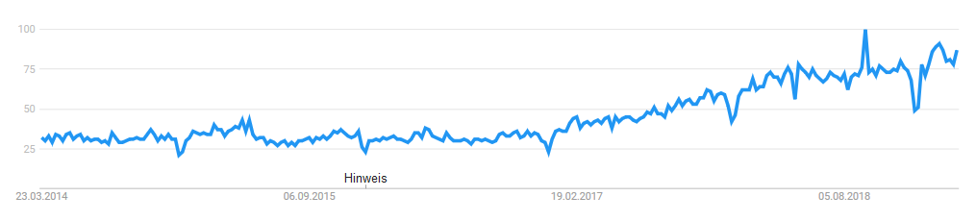
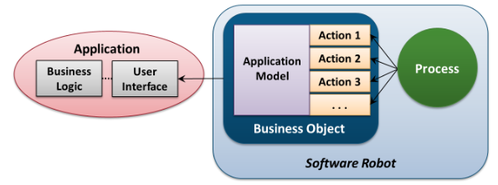
Process automation in the are of blue-collar & white-collar workers
https://ifr.org/ifr-press-releases/news/global-industrial-robot-sales-doubled-over-the-past-five-years
https://trends.google.ch/trends/explore?date=today%205-y&q=RPA
http://www.davidchappell.com/writing/white_papers/Introducing_Blue_Prism_v2--Chappell.pdf

Slide 4
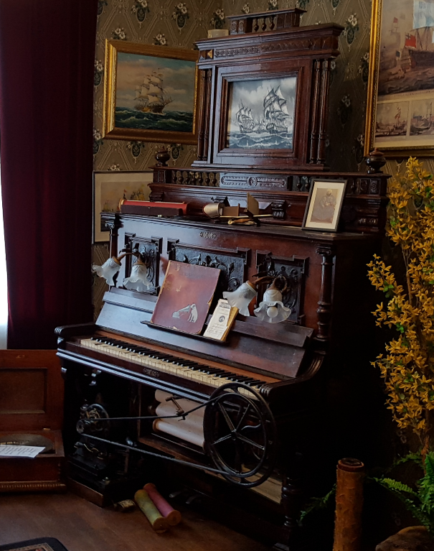
Our current design thinking of automation
Basic design assumptions:
E.g. functionality of a piano
Design of the UI
System construction (design an implementation)
Automation of a piano?
Activities from humans are replaced by an additional mechanism
Additional components are added as static part of the new system
Leverage White-Collar Workers with AI – Spring Symposium 2019
Notes:
This is the GUI in case of IT

Slide 5
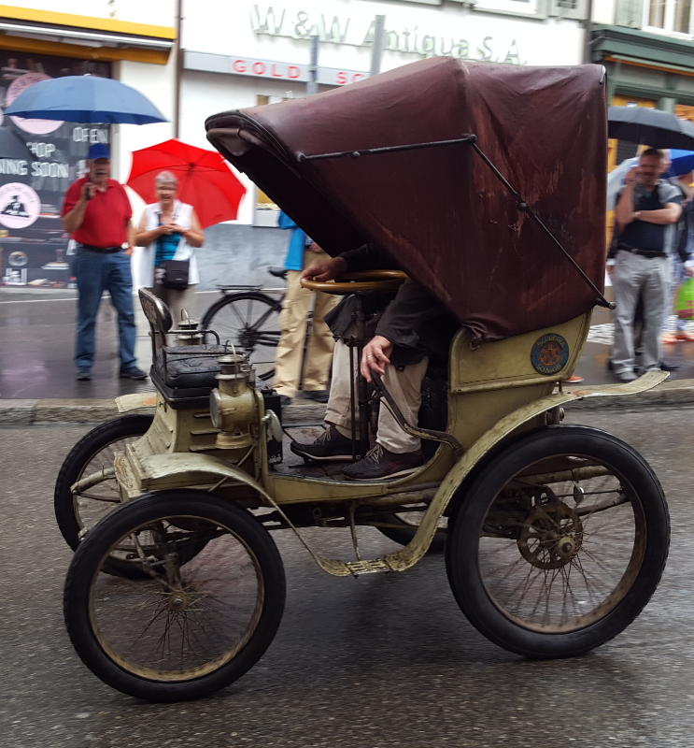
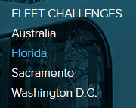
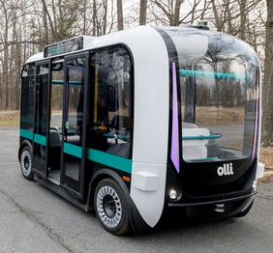
Adding AI components to cars: Ollie fleet challenge
Local Motors Debuts "Olli", the First Self-driving Vehicle to Tap the Power of IBM Watson
analyze and learn from high volumes of transportation data
more than 30 sensors embedded throughout the vehicle
Passengers will be able to interact conversationally with Olli while traveling from point A to point B
NLP (STT, TTS, entity extraction)
Questions: “Olli, can you take me downtown?”, “are we there yet?
recommendations for restaurants
What would you do with a fleet of autonomous shuttles? → Re-thinking about UI design
https://localmotors.com/florida-challenge/
https://www-03.ibm.com/press/us/en/pressrelease/49957.wss
Leverage White-Collar Workers with AI – Spring Symposium 2019
Notes:
co-creating the autonomous vehicle disruption
Australien/ Florida: Olli Fleet Challenge: (deadline 27 March 2019)
propose short-term, best-use scenarios for the self-driving shuttle, which is already operating at Sacramento State and in cooperation with a public transit system in Australia.
-combines artificial intelligence, augmented reality, and smartphone apps
serve people with vision, hearing, physical, and cognitive disabilities.
35km/h : cities, counties, airports, companies, and universities
Voice & text on iPad
trials in Germany and Switzerland

Slide 6
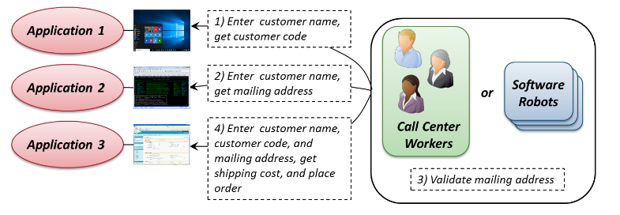
RPA: Rethinking about repetitive tasks of white-collar workers
man
machine
http://www.davidchappell.com/writing/white_papers/Introducing_Blue_Prism_v2--Chappell.pdf
Automation based on rules and knowledge engineering

Slide 7
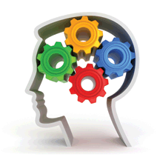

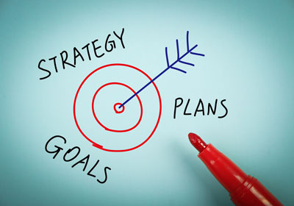
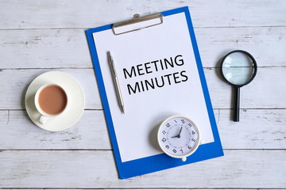
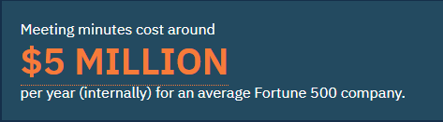
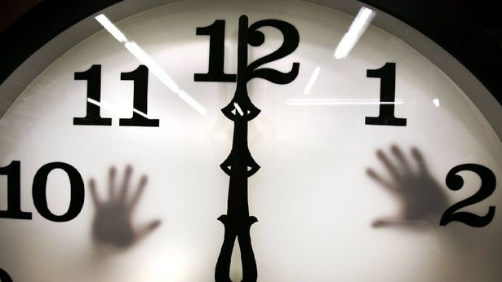
Create meeting minutes – expensive white-collar worker tasks in organizations
Meetings vehicle for achieving objectives in organizations
25-80% of time
in meetings
Meeting minutes as a representation of a meeting
IBM estimates 5 Million USD for average Fortune 500 company for meeting minutes
10-32 hours in a
40 hours work week

Slide 8

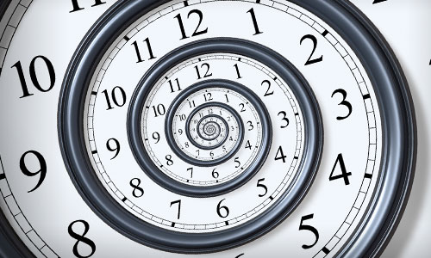
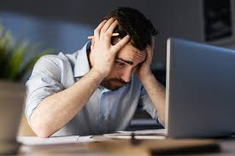

Typical problems in creating meeting minutes
Insufficient note-taking Speed of conversation flow
Time-consuming
3 Difficulties
Incomplete
Inconsistent
Inaccurate
Limited participation
Recall of information
after the meeting is challenging
Schiller (2009); Yu & Nakamura (2010); Halsey (2017); Mannering (2011)

Slide 9
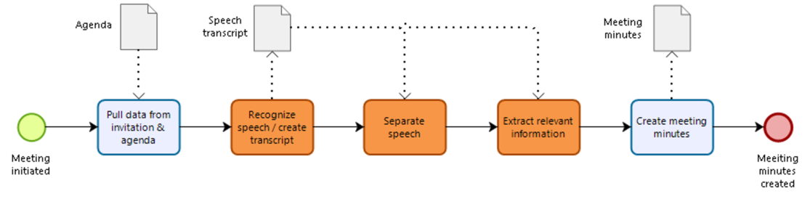




Towards a meeting minutes assistant – master thesis statement
AI-tasks
Scheduling
Speech recognition
Speech separation
Information extraction
Document creation
Used software for the simulations
Speech recognition: Otter.ai & Watson STT
Speech separation: Otter.ai & Watson STT
Information extraction: Reason8.ai & SpaCy.io
“An AI technology powered virtual assistant can support in the creation of meeting minutes during a face-to-face meeting captured by a mobile device into a predefined meeting minute template.”
Notes:
Meeting Minutes Assistant:
R1: What problems can be identified in creating meeting minutes?
R2: What are the requirements for an information system to create meeting minutes?
R3: To what extent can a speech recognition system support the speech-to-text transcription so that it still contains the relevant information from the meeting?
R4: To what extent does a speech recognizer separate multiple voices in a meeting?
R5: To what extent does a particular NLP component extract information from the speech-to-text transcript?

Slide 10

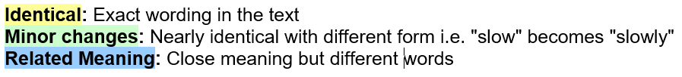
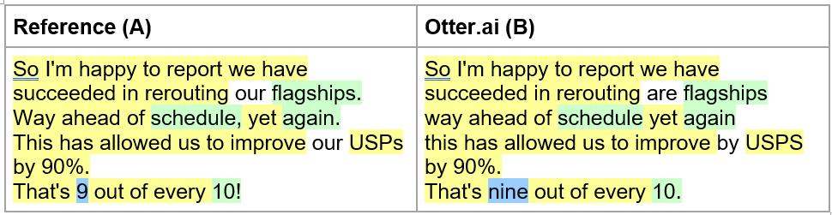
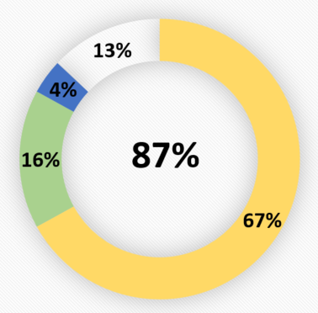
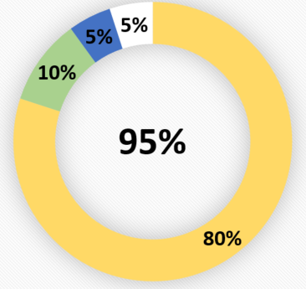
Meeting minutes generation: observations, findings & conclusion
Identified problems by humans:
70% report difficulties to capture the content:
Speed of the utterance
Extraction of relevant information (26%)
Completeness of decisions (14% succeed, 57% partly failed, 29% failed substantially)
NLP tools:
Not all AI technologies are mature enough for fully automated meeting minutes
Speech separation: “cocktail party problem”
NLU, NER, extracting decisions and action items
STT: the generated transcript provides great value for reconstructing the information after the meeting
Speech recognition analysis with
Watson STT
Otter.AI
Notes:
“named entity recognition” (NER), but no considerable results have been found so far that would allow automating this task entirely (Goyal, 2018).
Reason 8, a smartphone app, claims to extract decisions and action items (Reason8.ai,2018) + a least two devices are required

Slide 11
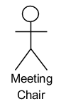
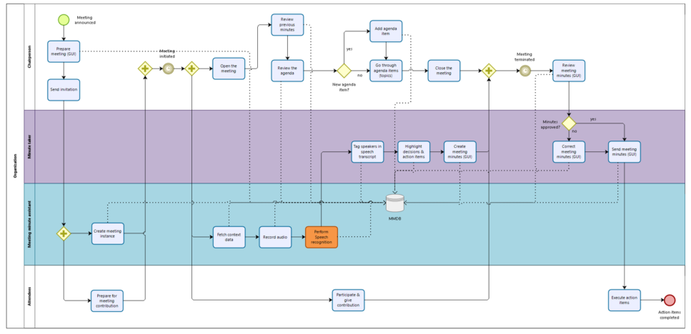
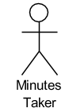
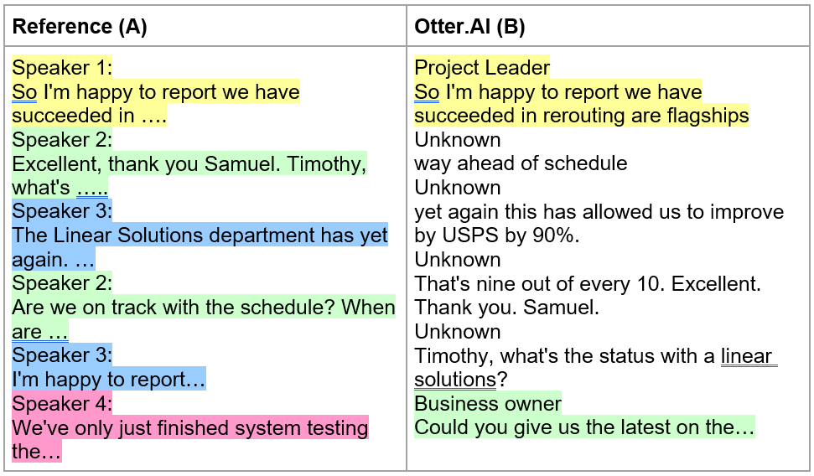
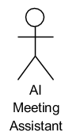
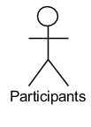
Re-designing the meeting minutes creation process with humans & AI
AI-tasks
Create meeting instance
Fetch context data
Record audio
Speech recognition
Human tasks
Speech separation
Information extraction
Tagging & labeling
Notes:
Create meeting instance Fetch context data Record audio
Meeting Minuts Assistant:
- Prepare, schedule meeting, fetch context data,

Slide 12
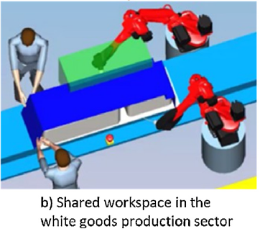
Coming up with Co-working scenarios for blue-collar & white collar workers! From a static, traditional HCI – towards a process-oriented collaborative workplace
UML use case diagrams:
Michalos et.al. 2018. A method for planning human robot shared
tasks, In CIRP Journal of Manufacturing Science and Technology
Incorporate human and AI actors in early system design upfront!
Notes:
Michalos G., Spiliotopoulos J., Makris S., and Chryssolourislem
G. Solving. 2018. A method for planning human robot shared
tasks, In CIRP Journal of Manufacturing Science and Technology,

Slide 13
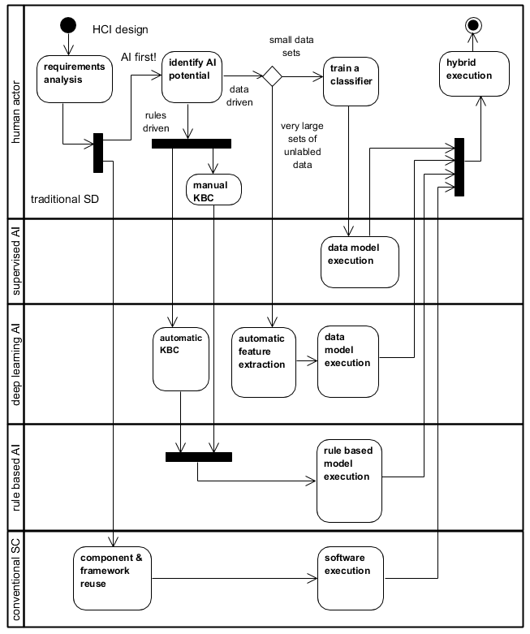
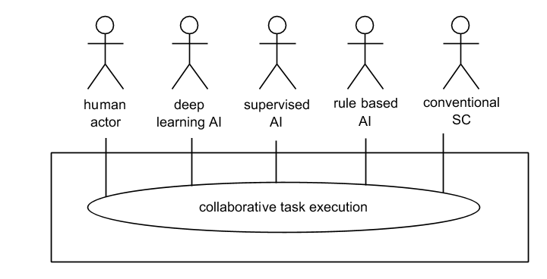
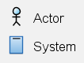
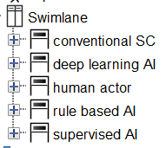
Rethinking AI-oriented system design: → Adding AI as actors NOT as systems

Slide 14
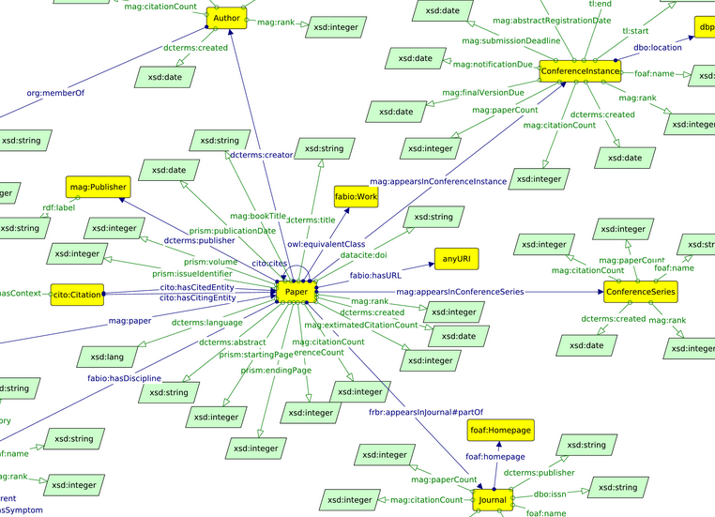
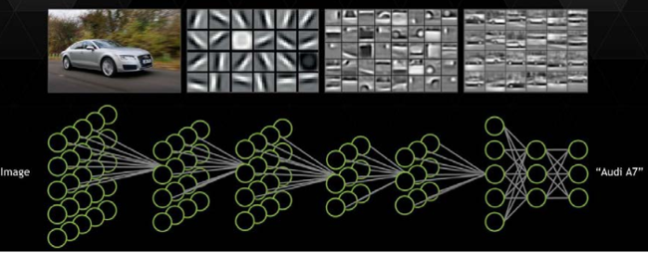
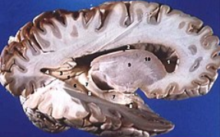
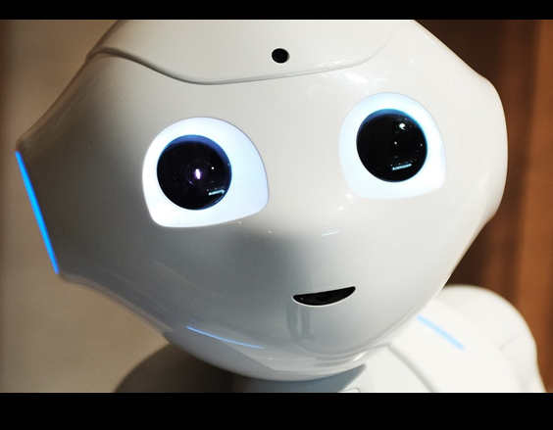
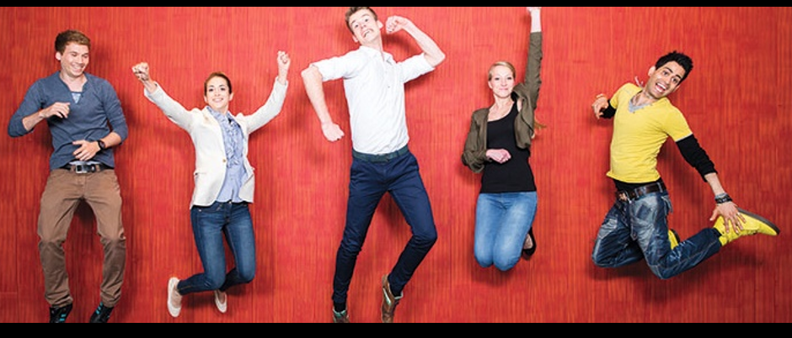
Combining & designing the systems using appropriate strengths: Knowledge Engineering + Machine Leaning + Human skills
Image source: Unsupervised Learning, Comm. ACM 2011, Lee et al.
https://en.wikipedia.org/wiki/Grey_matter
Notes:
https://www.google.com/imgres?imgurl=http%3A%2F%2Fma-graph.org%2Fwp-content%2Fuploads%2F2018%2F12%2Fmag-rdf-schema.png&imgrefurl=http%3A%2F%2Fma-graph.org%2Fschema-linked-dataset-descriptions%2F&docid=o5UIblShC2H1OM&tbnid=v6Z51gHZb2-pxM%3A&vet=10ahUKEwjE6Zzb_5bhAhUGuRoKHVzhDWkQMwhvKCMwIw..i&w=4484&h=2811&client=firefox-b&bih=656&biw=1338&q=knowledge%20graph%20ontology&ved=0ahUKEwjE6Zzb_5bhAhUGuRoKHVzhDWkQMwhvKCMwIw&iact=mrc&uact=8

Slide 15

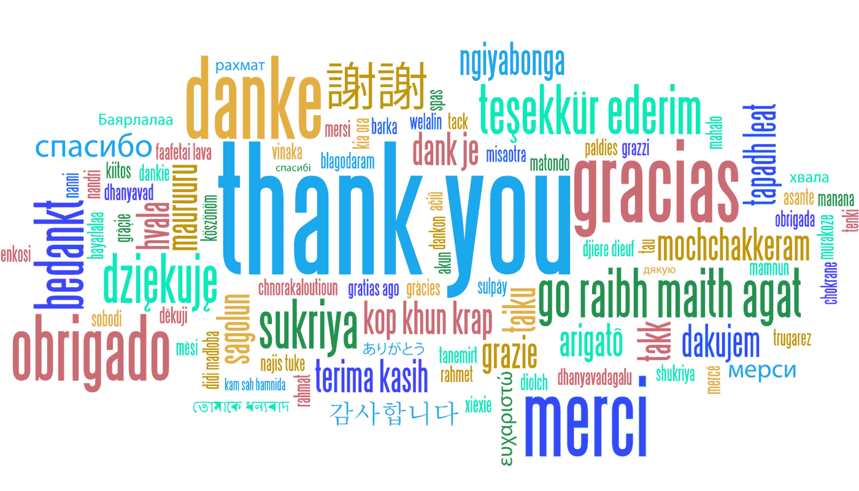
Questions & Discussion

Slide 16
Additional Slides
Towards a Meeting Minute Assistant
Supervisor: Dr. Stephan Jüngling
Examiner: Dr. Terry Inglese
Student: Angelin Hofer

Slide 17
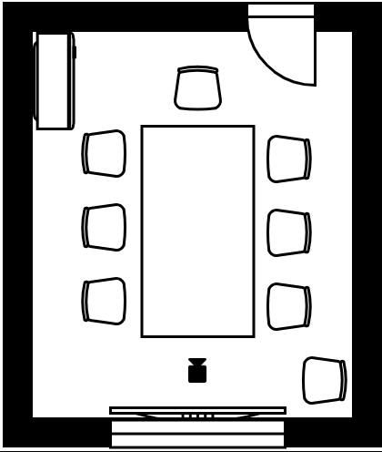
a) Observation
Setup:
Observer
7 informants
Camera
Screen
Procedure:
Presentation
Minute-taking of Video with template
Feedback Form

Slide 18
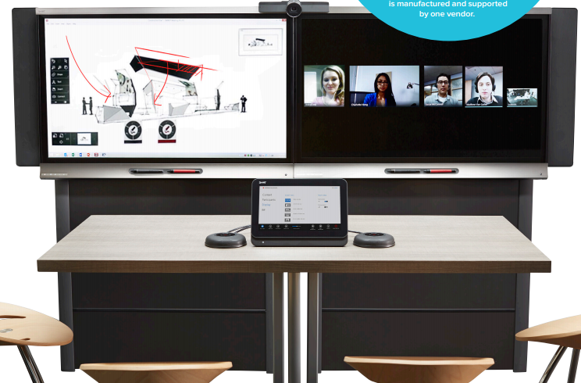
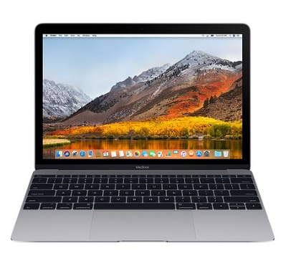
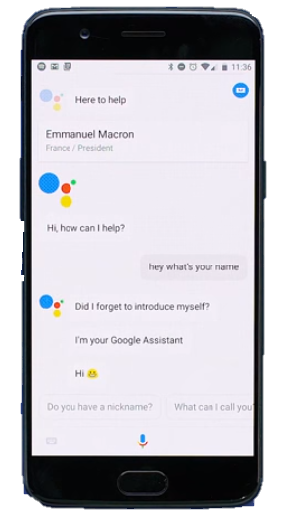
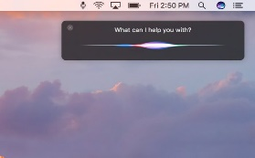
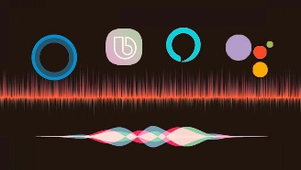
Smart Meeting Systems & VAs
Stationary
Mobile

